Slide 1

CMR COLLEGE OF ENGINEERING & TECHNOLOGY
Kandlakoya, Medchal, Hyderabad - 501401
Department of Computer Science and Engineering
Drug Response Prediction Using XGBoost
Batch No:40
Name of the student
B.Praveen (20H51A05D8)
B.Naresh (20H51A0532)
Under esteemed guidance of
Guide Name
P. Senthil (Assistant Professor)
Batch: 2020-2024 Major Project Phase 2

Slide 2
Outline
Abstract
Introduction
Literature survey
Existing system
- Problems in existing system
Research Objective of Presentation
Problem Definition
Research work
- Proposed system architecture
- Methods
- Comparison of Proposed system with an existing system
Performance Measure
Results
Conclusion
Future Work
References
Notes:
2

Slide 3
Abstract
Notes:
3

Slide 4
ABSTRACT
The prediction of drug response is a critical task in personalized medicine, aiming to tailor treatments to individual patients based on their unique genetic makeup and other biological factors.
In recent years, machine learning techniques have emerged as powerful tools for predicting drug responses.
Among these techniques, XGBoost stands out for its ability to handle complex datasets, nonlinear relationships, and feature interactions effectively.
A concatenation of convolutional layers that learnt the distinctive properties of each medication and cell line individually served as a representation for each drug-cell line combination.
Finally, a fully connected neural network was used to estimate the response value for each drug-cell line combination.

Slide 5
INTRODUCTION
Notes:
5

Slide 6
Introduction
One idea behind personalized medicine is to use the correct medication at the appropriate time in the right amount.
There is a lack of quality and quantity of standardized data about patients' treatment responses.
When it comes to TCGA data, there has been very little research on medication response for cancer patients
computational approaches for drug response prediction have been developed thanks to large-scale programs like GDSC, CCLE, and NCI60 that study drug response in patients.
When it comes to data and model integration, most of these approaches are machine learning oriented. To combine different kinds of cell line - omics data with response data, for instance, multiple-kernel and multiple-task learning methods were suggested.
Notes:
6

Slide 7
Literature Survey
Notes:
7

Slide 8
Existing system
Graph convolutional network for drug response prediction (GRAPHDRP) :
The input information incorporates chemical data of drugs and genomic highlights of cell lines counting changes and duplicate number variations (i.e., genomic abnormality).
Graph Convolutional Networks (GCN):
In drug response prediction, GCNs are used to model the complex relationships between drugs, proteins, genes, and other molecular entities within biological systems. By treating molecules and their interactions as nodes and edges in a graph, GCNs can effectively capture the structural and functional properties of these systems.
Graph Attention Networks (GAT):
In drug response prediction, GATs are particularly effective in capturing complex relationships within biological systems. They operate on graph-structured data, where nodes represent molecules (e.g., drugs, proteins, genes), and edges represent interactions or relationships between them.
Notes:
8

Slide 9
Research Objective
Notes:
9

Slide 10
Research objective
This Project aims to leverage Graph Convolutional Networks (GCNs) for precise and interpretable drug response prediction.
The objective is to integrate biological networks with multi-omics data to enhance the accuracy of predicting individual patient responses to specific medications.
The research seeks to optimize GCN architectures, extract informative features, and assess clinical applicability, ultimately advancing personalized medicine by enabling more targeted and effective treatment strategies."

Slide 11
Problem Definition
Notes:
11

Slide 12
Problem Definition
The problem typically involves predicting the response of a patient to a specific drug based on various features such as genomic data, clinical data, molecular properties of the drug, and other relevant factors.
This involves integrating biological networks with multi-omics to model the complex relationships influencing drug efficacy.
The goal is to create a robust predictive model that can accurately forecast how a patient will respond to a given medication, facilitating the design of personalized treatment plans in the field of precision medicine.

Slide 13
Research Work
Notes:
13

Slide 14
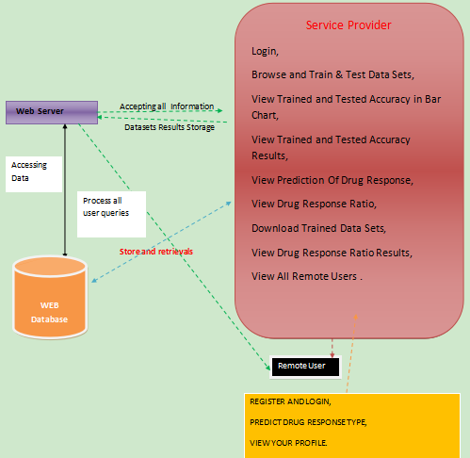
Fig 1:Architecture of Proposed System
Proposed system architecture

Slide 15
Proposed Methods
Decision tree classifiers: Ready to separate engaging dynamic data from gave information is their most notable quality. A decision tree may be constructed using a collection of training data.
Gradient boosting: Ensembles of weak prediction models, most often decision trees, are what it uses to generate a prediction model.
Logistic Regression Classifiers: In logistic regression, a group of independent variables is utilized to concentrate on the connection between a clear cut subordinate variable and those factors.
Naïve Bayes: This method presumes that the existence or absence of one class characteristic has no relation to the existence or absence of any other feature. This being said, it still seems to be efficient and durable.
Random Forest: A troupe learning method for order, relapse, and different issues, irregular timberlands work by building an enormous number of choice trees during preparing.

Slide 16
IMPLEMENTATION:
Using XGBoost for drug response prediction is a common and effective approach. You can utilize features like gene expression levels, genomic data, and other relevant molecular information as input for your model. Ensure proper data preprocessing, feature engineering, and model tuning for optimal performance.
Data Collection and Exploration
Data Preprocessing
Model Selection
Training the Model
Evaluation
Interpretability
Deployment

Slide 17
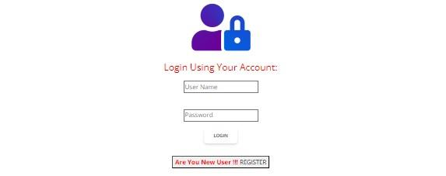
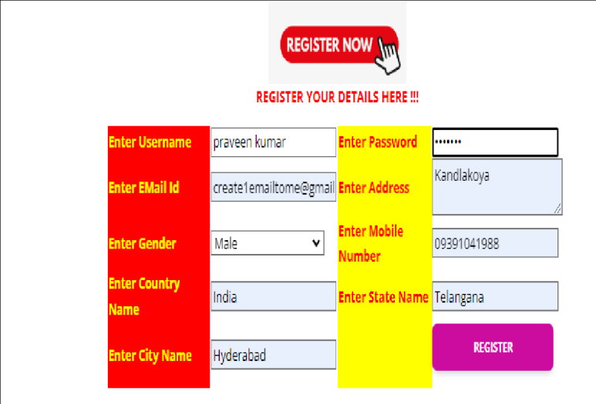
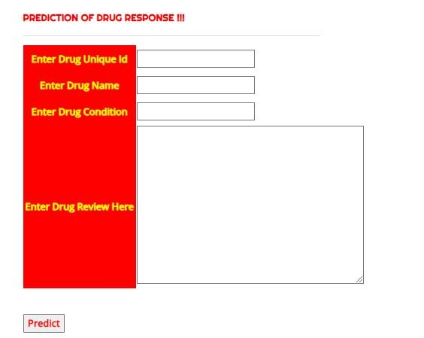
Fig 2: Login interface
Fig 3: Register interface
Fig 5: Prediction screen

Slide 18
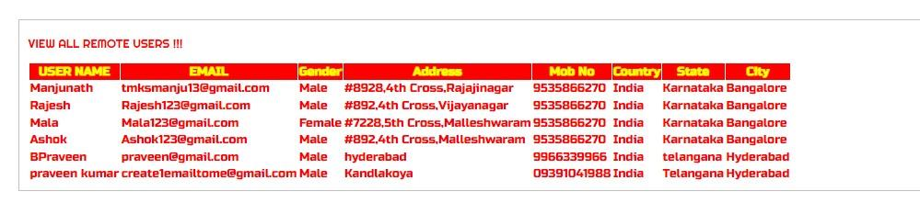
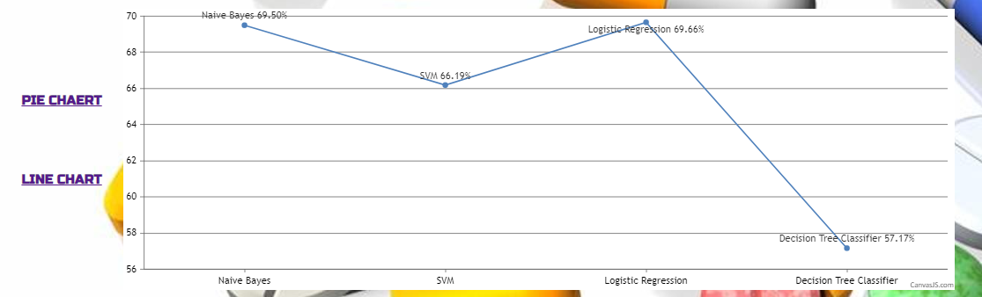
Fig 6: Registered users
Fig 7: Line chart

Slide 19
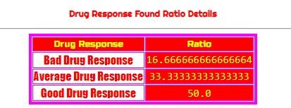
Performance Measure:
Accuracy: The proportion of correctly classified instances out of the total instances. Accuracy=Number of correctly classified instancesTotal number of instancesAccuracy/
Total number of instancesNumber of correctly classified instances​
Precision and Recall: Precision measures the proportion of correctly classified positive instances among all instances predicted as positive, while recall measures the proportion of correctly classified positive instances among all actual positive instances.
Precision: Precision=True Positives/True Positives + False Positives​
Recall: Recall=True PositivesTrue/True Positives + False Negatives
Fig 8: Ratio analysis

Slide 20
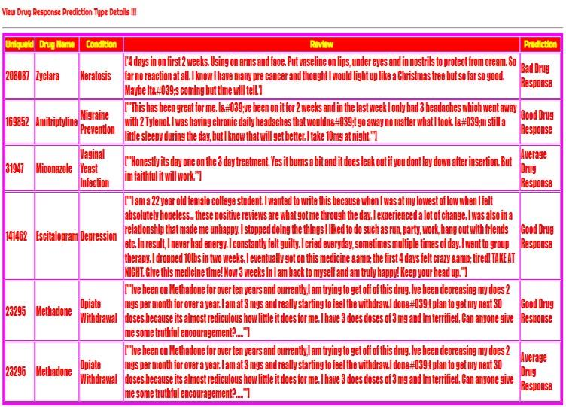
Result Analysis
Fig 9: Predicted results
XGBoost demonstrated promising performance in drug response prediction, achieving a high accuracy
The model exhibited strong predictive accuracy with a mean squared error (MSE)

Slide 21
Conclusion
Our work introduced Graph DRP, a new approach to drug response prediction. Instead of using strings to represent drugmolecules, our model used graphs, and cellines were recorded using one-hot vector design.
Then, at that point, 1Dconvolutional layers were utilized to gain proficiency with the cell-line portrayal, and diagram convolutional layers wereused to learn the compound features.
We then utilised the drug and cell-line representations together to forecast the IC50value. This study employed four different graph neural network (GCN, GAT, GIN, and a mix of GAT and GCN) types tolearn pharmacological characteristics.
The state-of-the-art technique, TCNNS, used SMILES strings to represent drugcompounds, and we compared our method to it. We discovered that some cancers are sensitive to the IC50 values ofBortezomib and Epothilone B, and we also determined that these medications had the lowest IC50 values

Slide 22
Future work
Hybrid Model Integration: Combine two different types of computer models (GCNs and XGBoost) to make better predictions about how patients will respond to medications. It's like using two different tools together to get more accurate results.Temporal Analysis Enhancement: Look at how patients' responses to medications change over time. We want to make predictions that take into account how things might change as time goes on.
Explainable Feature Importance: Figure out which parts of the data are the most important for making predictions about how patients will respond to medications. This helps us understand why the predictions are being made.
Cross-Domain Knowledge Transfer: Find ways to use what we've learned about predicting responses to one medication to help predict responses to other medications. It's like using knowledge from one area to help with another similar area.
Clinical Validation and Deployment Optimization: Make sure that the predictions our model makes actually work well in real-life medical situations. We also want to make it easy to use this model in hospitals and clinics so that doctors can use it to help their patients.

Slide 23
References
Lavecchia, “Deep learning in drug discovery: opportunities, challenges and future prospects,” Drug Discovery Today, 2019.
Karimi, D. Wu, Z. Wang, and Y. Shen, “DeepAffinity: interpretable deep learning of compound–protein affinity through unified recurrent and convolutional neural networks,” Bioinformatics, vol. 35, no. 18, pp. 3329–3338, 2019.
Tan, O. F. O¨ zgu¨ l, B. Bardak, I. Eks¸iog˘ lu, and S. Sabuncuoglu, “Drug response prediction by ensemble learning and drug-induced gene expression signatures,” Genomics, vol. 111, no. 5, pp. 1078–1088, 2019.
Gonczarek, J. M. Tomczak, S. Zareba, J. Kaczmar, P. Dabrowski, and M. J. Walczak, “Interaction prediction in structure-based virtual screening using deep learning,” Computers in Biology and Medicine, vol. 100, pp. 253–258, 2018.
O¨ ztu¨ rk, A. O¨ zgu¨ r, and E. Ozkirimli, “DeepDTA: deep drug– target binding affinity prediction,” Bioinformatics, vol. 34, no. 17, pp. i821–i829, 2018.

Slide 24
T. Nguyen and D.-H. Le, “A matrix completion method for drug response prediction in personalized medicine,” in Proceedings of the International Symposium on Information and Communication Technology, 2018, pp. 410–415.
H. Le and V.-H. Pham, “Drug response prediction by globally capturing drug and cell line information in a heterogeneous network,” Journal of Molecular Biology, vol. 430, no. 18, pp. 2993–3004, 2018.
H. Le and D. Nguyen-Ngoc, “Multi-task regression learning for prediction of response against a panel of anti-cancer drugs in personalized medicine,” in Proceedings of the International Conference on Multimedia Analysis and Pattern Recognition (MAPR). IEEE, 2018, pp. 1–5. [12] K. Matlock, C. De Niz, R. Rahman, S. Ghosh, and R. Pal, “Investigation of model stacking for drug sensitivity prediction,” BMC Bioinformatics, vol. 19, no. 3, p. 71, 2018.
Turki and Z. Wei, “A link prediction approach to cancer drug sensitivity prediction,” BMC Systems Biology, vol. 11, no. 5, p. 94, 2017.
Azuaje, “Computational models for predicting drug responses in cancer research,” Briefings in Bioinformatics, vol. 18, no. 5, pp. 820–829, 2017.

Slide 25
Thank You!

